Slide 1
Hotel Reservation analysis (with Sql)
Presentation By : Logeshwari R

Slide 2
Introduction
In today's hospitality industry, data plays a pivotal role in shaping operational strategies and enhancing guest satisfaction. Hotels gather vast amounts of data from reservations, which, when analyze defectively , provide valuable insights into guest preferences, booking patterns, and operational efficiency. In this project, we delve into a of a hotel reservation dataset using SQL, a powerful language for managing and querying structured data.

Slide 3
Dataset Overview
The dataset includes the following columns:
Booking_ID: A unique identifier for each hotel reservation.
No_of_adults: The number of adults in the reservation.
No_of_children: The number of children in the reservation.
No_of_weekend_nights: The number of nights in the reservation that fall on weekends.
No_of_week_nights: The number of nights in the reservation that fall on weekdays.
Type_of_meal_plan: The meal plan chosen by the guests.
Room_type_reserved: The type of room reserved by the guests.
Lead_time: The number of days between booking and arrival.
Arrival_date: The date of arrival.
Market_segment_type: The market segment to which the reservation belongs.
Avg_price_per_room: The average price per room in the reservation.
Booking_status: The status of the booking

Slide 4
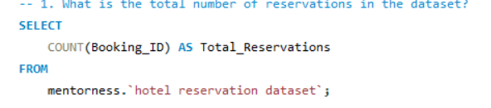
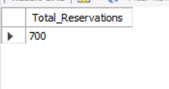
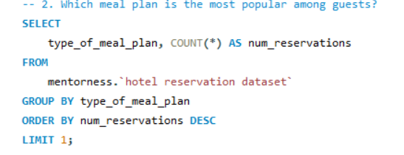

1. What is the total number of reservations in the dataset?
2. Which meal plan is the most popular among guests?

Slide 5
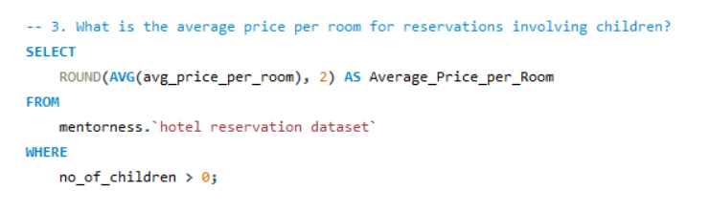

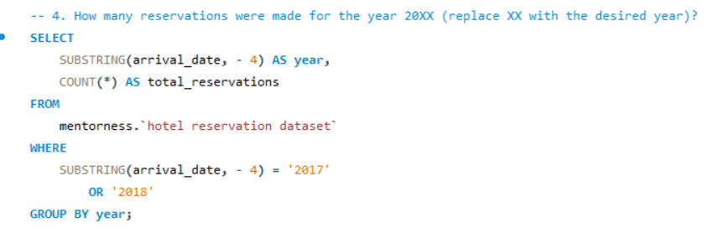
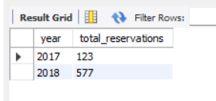
3. What is the average price per room for reservations involving children?
4. How many reservations were made for the year 20XX (replace XX with the desired year)?

Slide 6
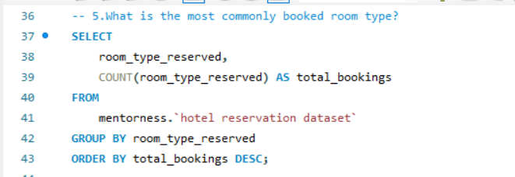
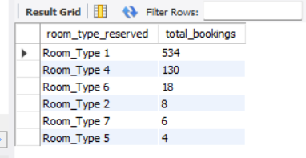
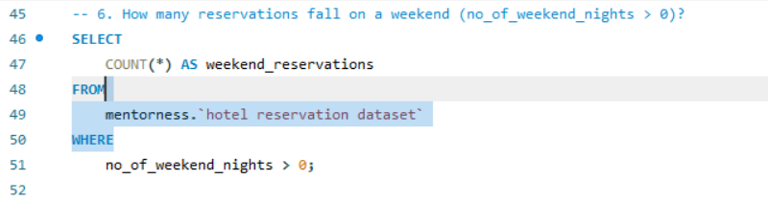
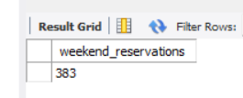
5. What is the most commonly booked room type?
6. How many reservations fall on a weekend (no_of_weekend_nights > 0)?

Slide 7
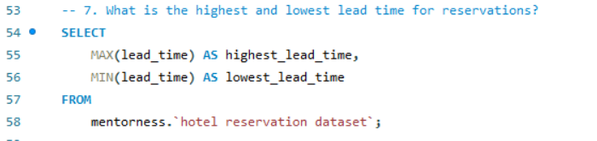
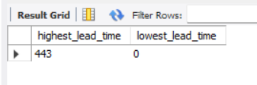
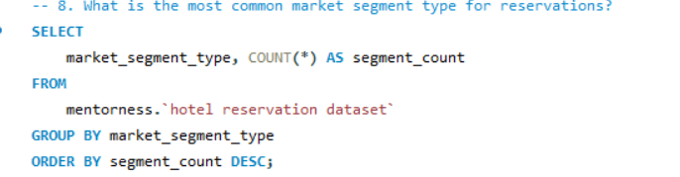
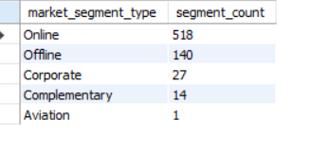
7. What is the highest and lowest lead time for reservations?
8. What is the most common market segment type for reservations?

Slide 8
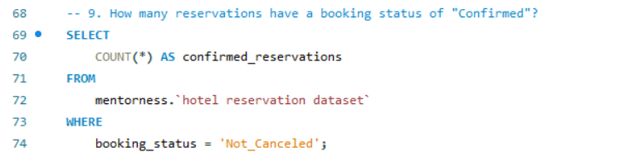
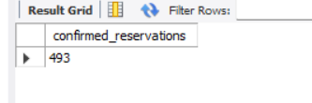
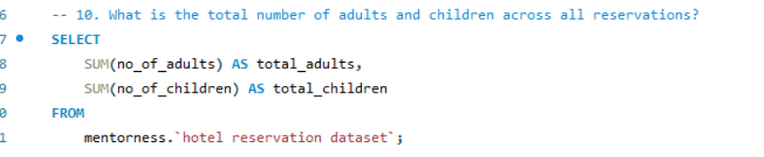
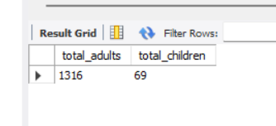
9. How many reservations have a booking status of "Confirmed"?
10. What is the total number of adults and children across all reservations?

Slide 9
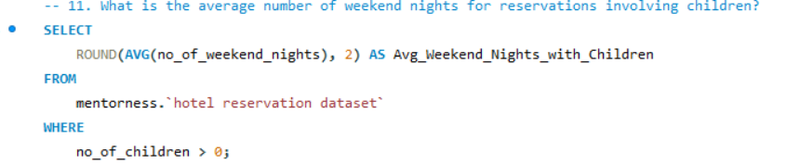
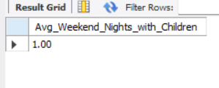
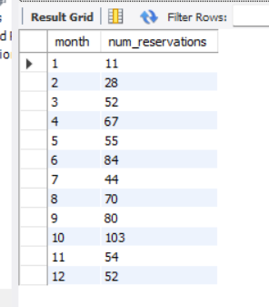
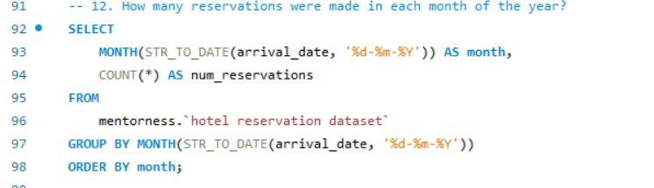
11. What is the average number of weekend nights for reservations involving children?
12. How many reservations were made in each month of the year?

Slide 10
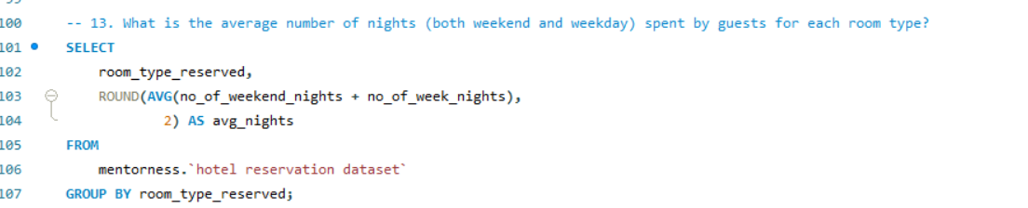
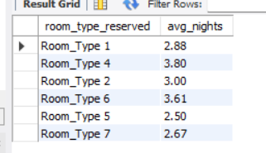
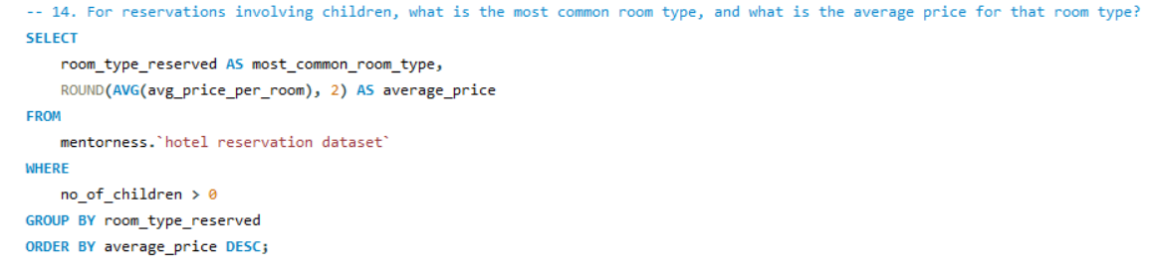
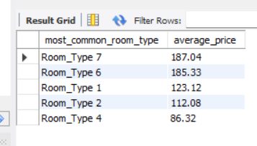
13. What is the average number of nights (both weekend and weekday) spent by guests for each room type?
14. For reservations involving children, what is the most common room type, and what is the average price for that room type?

Slide 11
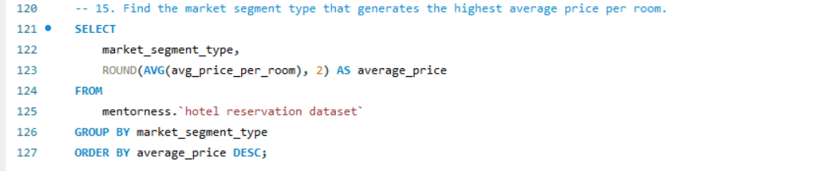
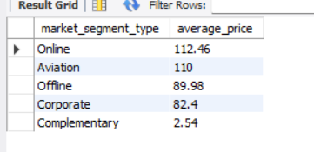
15. Find the market segment type that generates the highest average price per room.

Slide 12
Conclusion
1. In 2017, September and October saw the highest number of reservations. In 2018, the peak months were March, April, May, June, August, and October.
2. Out of 700 reservations, 493 were confirmed, indicating that approximately 70% of reservations were confirmed while 30% were canceled.
3. Around 73% of customers booked their hotel rooms online.
4. Room_type_1 was the most popular room type among customers.
5. Meal plan_1 was the most popular meal plan among guests. For families with children, Room_type_1 was also the most preferred room type.
6. The dataset includes 69 children and 1316 adults.

Slide 13
Recomendation
Enhance Meal Plans: Expand and promote popular 01 meal plans to boost guest satisfaction.
Family Packages: Create special offers targeting, based on preferred room types and pricing.
Seasonal Promotions: Implement targeted marketing campaigns for peak and off-peak seasons to maximize occupancy.
Optimize Room Allocation & Early Booking Incentives : Manage inventory based on the most commonly booked room types and average stay duration. Offer discounts to encourage early reservations and reduce last-minute bookings.

Slide 14
THANK YOU

